Slide 1
Welcome to my Presentation
Submitted To:
Md.Mahbub-E-Noor
Lecturer
Department of CSE
University of Barishal
Submitted By:
Naymur Rahman
Roll: 13
Batch: 68

Slide 2
Topic
Online Shop Entrepreneurship Among Students

Slide 3
Table of Contents
Introduction to Online Shop Entrepreneurship
The Impact Of University Support On The Creation Of Student Entrepreneurs
Motivation for students to become online shop traders
The impact felt by online shop selling students
Digital Marketing Strategies
Skills Developed Through Online Entrepreneurship
Future Trends in Online Entrepreneurship
Conclusion and Call to Action

Slide 4
Introduction to Online Shop Entrepreneurship
Online shop entrepreneurship has become increasingly popular among students.
This trend allows students to balance their academic commitments while exploring business opportunities.
Online shop entrepreneurship, also known as e-commerce entrepreneurship, involves starting and running a business that sells products or services directly to customers through an online platform, allowing them to browse, select, and purchase items conveniently via the internet, essentially creating a virtual storefront accessible 24/7 from anywhere with an internet connection.
Notes:
Image source: https://www.slidemake.com

Slide 5

The Impact Of University Support On The Creation Of Student Entrepreneurs
Concept Development Support (CDS) pertains to the guidance and assistance provided by universities to students in the early stages of their entrepreneurial journey. This support includes motivation, awareness, and knowledge of business concepts to help students bring their innovative ideas to fruition.
Notes:
Image source: https://www.teambonding.com

Slide 6

Motivation for students to become online shop traders
Students might be motivated to become online shop traders due to factors like flexibility in work hours, potential for high earning potential, the ability to pursue personal interests through product selection, minimal startup costs, entrepreneurial freedom, and the chance to learn valuable business skills while still studying or working part-time.
Notes:
Image source: https://fourweekmba.com

Slide 7
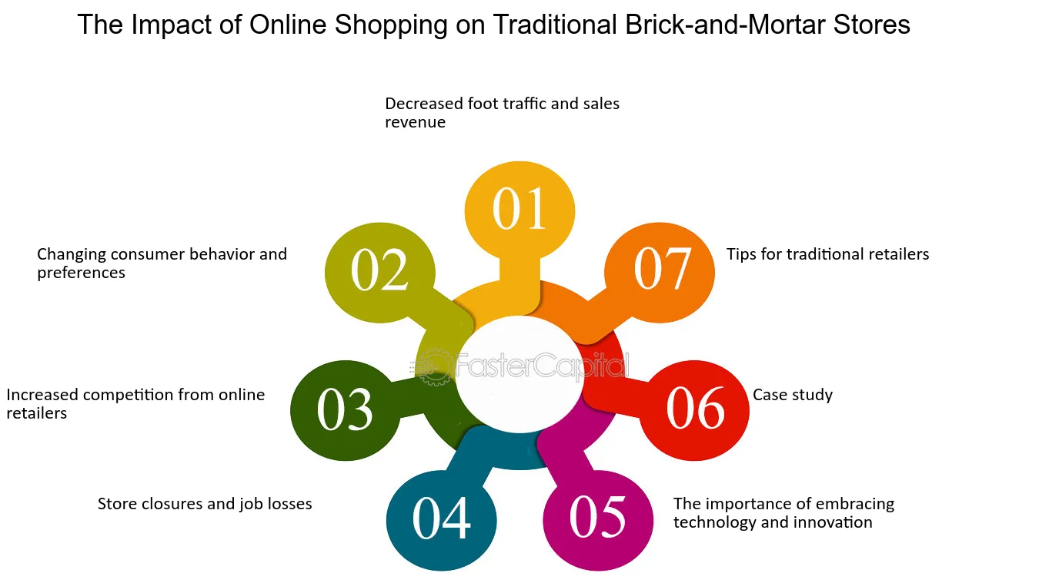
The impact felt by online shop selling students
Online shops catering to students have seen significant growth due to the convenience of shopping, wide product selection, and competitive prices. Students benefit from easy access to textbooks, tech gadgets, and everyday essentials. However, challenges include fierce competition, pricing pressures, and the need for effective digital marketing strategies.

Slide 8
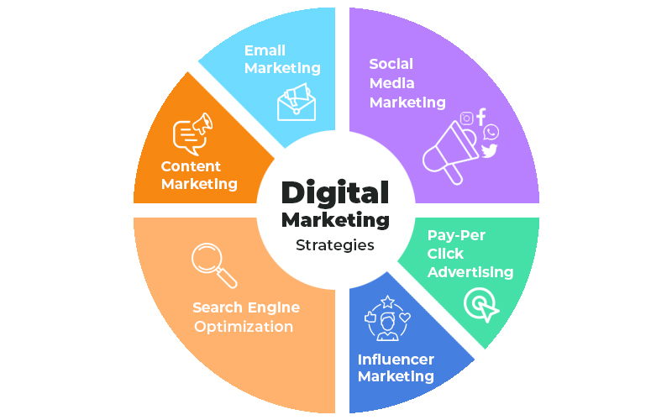
Digital Marketing Strategies
Social media marketing plays a crucial role in reaching potential customers effectively.
Search engine optimization (SEO) can enhance a shop's visibility on search engines.
Email marketing is an effective way to retain customers and promote new products.
Notes:
Image source: https://www.slidemake.com

Slide 9

Skills Developed Through Online Entrepreneurship
Students can develop essential entrepreneurial skills, including critical thinking and creativity.
Managing an online shop fosters financial literacy as students track income and expenses.
Communication skills are enhanced through customer interactions and marketing efforts.
Notes:
Image source: https://idreamcareer.com

Slide 10

Future Trends in Online Entrepreneurship
The rise of social commerce suggests a growing integration of social media and online shopping.
Sustainable practices are becoming more important as consumers seek eco-friendly options.
Technological advancements, such as AI and AR, are expected to reshape the online shopping experience.
Notes:
Image source: https://socialpros.co

Slide 11
Conclusion and Call to Action
Online shop entrepreneurship offers a valuable opportunity for students to gain real-world experience.
By leveraging available resources, students can navigate the challenges and thrive.
Encouraging a culture of entrepreneurship can lead to innovation and economic growth within the student community.
Notes:
Image source: https://newsroom.smumn.edu

Slide 12
Thank you Everyone

